Slide 1
PERL Project: Identification of Promoter Region
Anusudan Nambiar, Gowri Roy, Prakruthi K R, Rajendra N S, Sandeep Laik
Westbred Team

Slide 2
Business value
Promoters are very much required for driving the desired gene expression
This project helps to locate a specific promoter region on DNA sequence
This script can be extended for finding other regulatory elements on DNA sequences too
GET team @ MRC extensively involved in identifying and characterizing the promoters. Scripts can replace the tools that’s being used

Slide 3
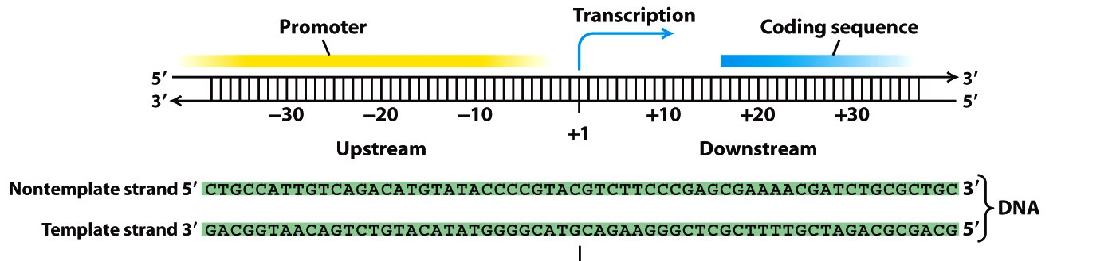
Strategy
Beginning
End
Sense Strand
1. TATA box :The TATA box is found in promoter region of most genes in eukaryotes
Considered to be the core promoter sequence
The binding site of either transcription factors or histones
2. CAAT Box :CAAT Box /CCAAT box is a conservedsequence in the promoter region of a gene in Eukaryotic Genomes.
Signals the binding site for the RNA transcription factor
One of the most wide spread promoter elements, being present in 25% of eukaryotic promoters
3.Transcription start site
4. Translation initiation site: ATG
Transcribed Strand

Slide 4
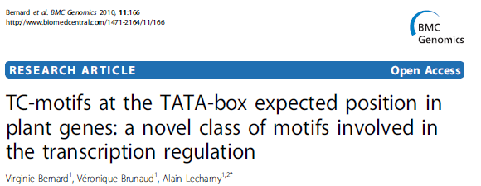
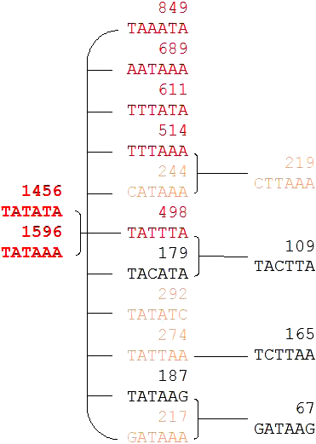
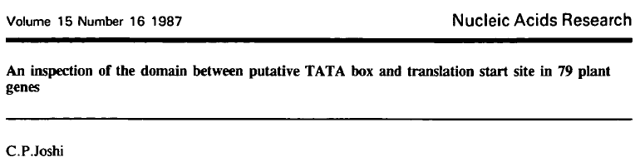
References

Slide 5
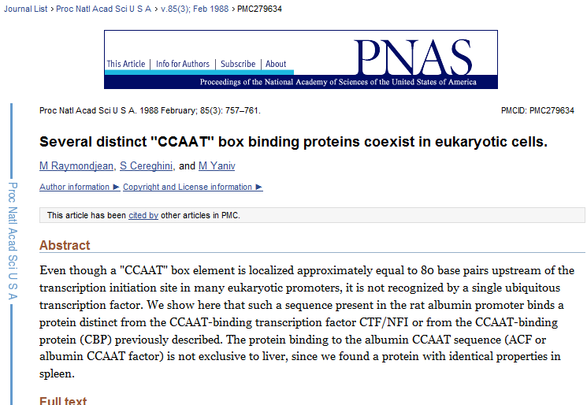
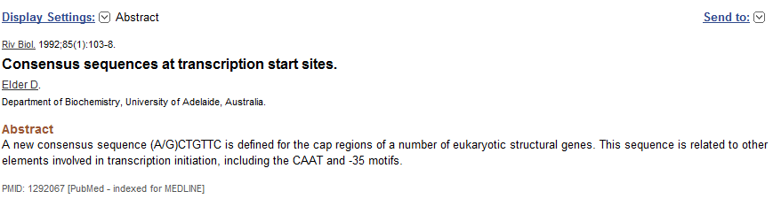

Slide 6
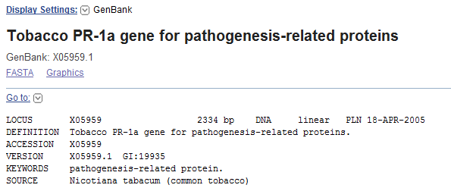
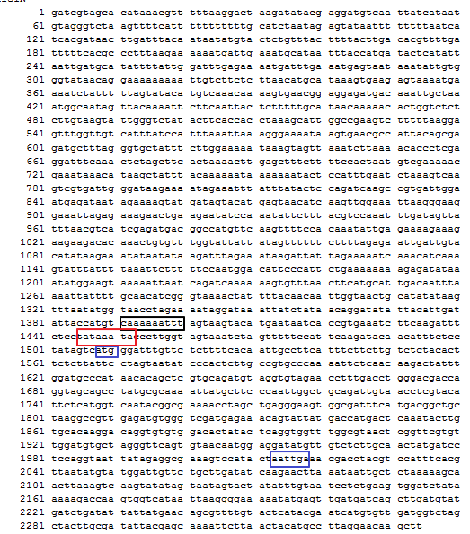
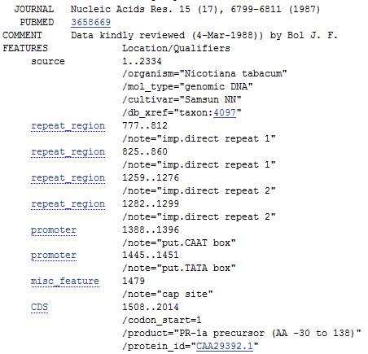
Reference sequence to run the script

Slide 7
Code
use strict;
use warnings;
## declare all the variables
my $hash="";
my $filename="sequence.txt";
#ATG box sequence
my $find="ATG";
my $counter1=0;
#TATA box sequence
my @find1=qw/TCACTATATATAG
TATTTAA
TATATA
TATAAA
TAAATA
AATAAA
TTTATA
CATAAA
TATTTA
TACATA
TATATC
TATTAA
TATAAG
GATAAA
CTTAAA
TACTTA
TCTTAA
GATAAG/;
#CAT box sequence
my @find2=qw/ACTGTTC
GCTGTTC
GTCAAAAAAT /;
#declare – End
#Code - Start
#pick the string from the file
open(FH1,$filename) or print "not found";
while(my $hashtag=<FH1>){
chomp $hashtag;
#print $hashtag;
$hash= $hash . $hashtag;
}
#print $hash, "\n\n\n";
print "Length of the sequence : " . length($hash), "\n\n\n";
#Find ATG Sequence
my $findresult1 = find($hash,$find);
#remove the extra trailing ',1' from the string
$findresult1 =~ s/\,1$//;
print "Sequence: " . $find . " positions:\n" . $findresult1 . "\n\n";
#Find TATA Box sequence;
foreach(@find1){
my $findresult2 = find($hash,$_);
#remove the extra trailing ',1' from the string
$findresult2 =~ s/\,1$//;
print "Sequence: " . $_ . " positions:\n" . $findresult2 . "\n";
};
#Find CAT box sequence;
foreach(@find2){
my $findresult2 = find($hash,$_);
#remove the trailing ',1' from the string
$findresult2 =~ s/\,1$//;
print "Sequence: " . $_ . " positions:\n" . $findresult2 . "\n";
};
#Search Engine
sub find
{
#confirm the combination sequence available
if (my @data = $_[0] =~ m/(.*)($_[1])(.*)/isg){
#concatenate and return a string of locations with the latest found location.
#also the line below makes a recursive call to the same function.
return $_[3]=$-[2] . "," . find($data[0],$data[1]);
}
else{print "\n";}
};
#Search Engine-END
#Code - End

Slide 8
Thank You!

